Slide 1


OCP 11 Part 1 [1Z0-819]
Dr.-Ing Mohamed Amine Mezghich
Associate Professor at ENSI, CEO of Smart IT Partner
JAVA/J2EE Certified Trainer
ma.mezghich@smart-it-partner.com
amine.mezghich@ensi-uma.tn

Slide 2
Chapter 2 : Operators and Statements
✓ Using Operators and Decision Constructs ■ Use Java operators; including parentheses to override operator precedence ■ Create if and if/else and ternary constructs ■ Use a switch statement ✓ Using Loop Constructs ■ Create and use while loops ■ Create and use for loops including the enhanced for loop ■ Create and use do/while loops ■ Compare loop constructs ■ Use break and continue

Slide 3
1- Understanding Java Operators
A Java operator is a special symbol that can be applied to a set of variables, values, or literals—referred to as operands—and that returns a result. Three ﬂavors of operators are available in Java: unary, binary, and ternary. These types of operators can be applied to one, two, or three operands, respectively.
For the OCA exam, you’ll need know a specific subset of Java operators, how to apply them, and the order in which they should be applied.

Slide 4
1- Understanding Java Operators
Java operators are not necessarily evaluated from left-to-right order. For example, the following Java expression is actually evaluated from right-to-left given the specific operators involved: int y = 4; double x = 3 + 2 * --y; In this example, you would first decrement y to 3, and then multiply the resulting value by 2, and finally add 3. The value would then be automatically upcast from 9 to 9.0 and assigned to x. The final values of x and y would be 9.0 and 3, respectively.

Slide 5
1- Understanding Java Operators
Unless overridden with parentheses, Java operators follow order of operation, listed in Table 2.1, by decreasing order of operator precedence.
If two operators have the same level of precedence, then Java guarantees left-to-right evaluation. You need to know only those operators in bold for the OCA exam.

Slide 6
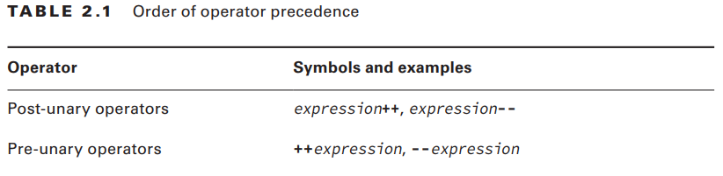
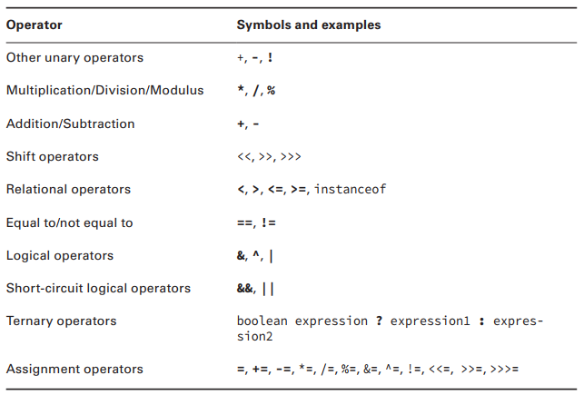
1- Understanding Java Operators
Note that you won’t be tested on some operators,
although we recommend that you be aware of their existence.

Slide 7
2-Working with Binary Arithmetic Operators
2-1) Arithmetic Operators Arithmetic operators are often encountered in early mathematics and include addition (+), subtraction (-), multiplication (*), division (/), and modulus (%). They also include the unary operators, ++ and --, although we cover them later in this chapter. noticed in Table 2.1, the multiplicative operators (*, /, %) have a higher order of precedence than the additive operators (+, -). That means when you see an expression such as this: int x = 2 * 5 + 3 * 4 - 8; you first evaluate the 2 * 5 and 3 * 4, which reduces the expression to the following: int x = 10 + 12 - 8;

Slide 8
2-Working with Binary Arithmetic Operators
2-1) Arithmetic Operators Then, you evaluate the remaining terms in left-to-right order, resulting in a value of x of 14. Make sure you understand why the result is 14 as you’ll likely see this kind of operator precedence question on the exam.
Notice that we said “Unless overridden with parentheses…” prior to Table 2.1. That’s because you can change the order of operation explicitly by wrapping parentheses around the sections you want evaluated first.

Slide 9
2-Working with Binary Arithmetic Operators
2-1) Arithmetic Operators Compare the previous example with the following one containing the same values and operators, in the same order, but with two sets of parentheses: int x = 2 * ((5 + 3) * 4 – 8); This time you would evaluate the addition operator 10 + 3, which reduces the expression to the following: int x = 2 * (8 * 4 – 8); Next; int x = 2 * (32 – 8); Next int x = 2 * 24; and finally
resulting in a value of 48 for x.

Slide 10
2-Working with Binary Arithmetic Operators
2-2) Numeric Promotion Rules You should memorize certain rules Java will follow when applying operators to data types: 1. If two values have different data types, Java will automatically promote one of the values to the larger of the two data types. 2. If one of the values is integral and the other is floating-point, Java will automatically promote the integral value to the floating-point value’s data type 3. Smaller data types, namely byte, short, and char, are first promoted to int any time they’re used with a Java binary arithmetic operator, even if neither of the operands is int. 4. After all promotion has occurred and the operands have the same data type, the resulting value will have the same data type as its promoted operands.

Slide 11
2-Working with Binary Arithmetic Operators
2-2) Numeric Promotion Rules
The last two rules are the ones most people have trouble with, and the ones likely to trip you up on the exam. For the third rule, note that unary operators are excluded from this rule.
For example, applying ++ to a short value results in a short value. We’ll discuss unary operators in the next section. Let’s tackle some examples for illustrative purposes:

Slide 12
2-Working with Binary Arithmetic Operators
2-2) Numeric Promotion Rules
What is the data type of x * y? int x = 1; long y = 33; If we follow the first rule, since one of the values is long and the other is int, and long is larger than int, then the int value is promoted to a long, and the resulting value is long

Slide 13
2-Working with Binary Arithmetic Operators
2-2) Numeric Promotion Rules
What is the data type of x + y? double x = 39.21; float y = 2.1; This is actually a trick question, as this code will not compile! As you may remember from Chapter 1, ﬂoating-point literals are assumed to be double, unless postfixed with an f, as in 2.1f. If the value was set properly to 2.1f, then the promotion would be similar to the last example, with both operands being promoted to a double, and the result would be a double value.

Slide 14
2-Working with Binary Arithmetic Operators
2-2) Numeric Promotion Rules
What is the data type of x / y? short x = 10; short y = 3; In this case, we must apply the third rule, namely that x and y will both be promoted to int before the operation, resulting in an output of type int. Pay close attention to the fact that the resulting output is not a short, as we’ll come back to this example in the upcoming section on assignment operators.

Slide 15
2-Working with Binary Arithmetic Operators
2-2) Numeric Promotion Rules
What is the data type of x * y / z? short x = 14; float y = 13; double z = 30;
In this case, we must apply all of the rules. First, x will automatically be promoted to int solely because it is a short and it is being used in an arithmetic binary operation.
The promoted x value will then be automatically promoted to a float so that it can be multiplied with y. The result of x * y will then be automatically promoted to a double, so that it can be multiplied with z, resulting in a double value.

Slide 16
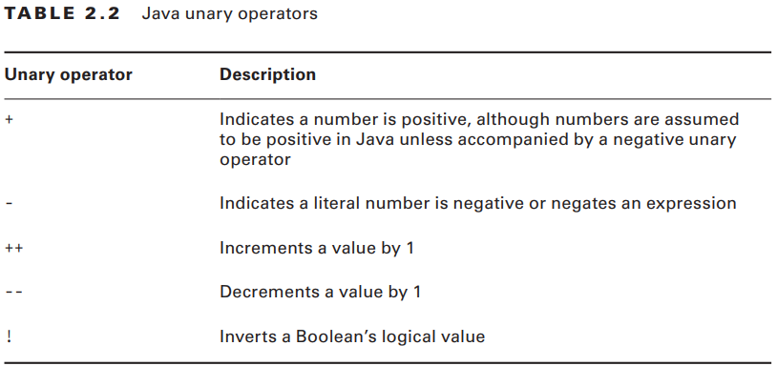
3-Working with Unary Operators
By definition, a unary operator is one that requires exactly
one operand, or variable, to
function.
As shown in Table 2.2,
they often perform simple tasks, such as increasing
a numeric variable by one,
or negating a boolean value.

Slide 17
3-Working with Unary Operators
3-1) Logical Complement and Negation Operators The logical complement operator, !, ﬂips the value of a boolean expression. For example, if the value is true, it will be converted to false, and vice versa. To illustrate this, compare the outputs of the following statements: boolean x = false; System.out.println(x); // false x = !x; System.out.println(x); // true

Slide 18
3-Working with Unary Operators
3-1) Logical Complement and Negation Operators Likewise, the negation operator, -, reverses the sign of a numeric expression, as shown in these statements: double x = 1.21;
System.out.println(x); // 1.21 x = -x; System.out.println(x); // -1.21 x = -x; System.out.println(x); // 1.21

Slide 19
3-Working with Unary Operators
3-1) Logical Complement and Negation Operators Based on the description, it might be obvious that some operators require the variable or expression they’re acting upon to be of a specific type. For example, you cannot apply a negation operator, -, to a boolean expression, nor can you apply a logical complement operator, !, to a numeric expression. Be wary of questions on the exam that try to do this, as they’ll cause the code to fail to compile.
For example, none of the following lines of code will compile:

Slide 20
3-Working with Unary Operators
3-1) Logical Complement and Negation Operators int x = !5; // DOES NOT COMPILE boolean y = -true; // DOES NOT COMPILE boolean z = !0; // DOES NOT COMPILE The last statement does not compile because you cannot take the logical complement of a numeric value, nor can you assign an integer to a boolean variable.
Keep an eye out for questions on the exam that use the logical complement operator or numeric values with boolean expressions or variables. Unlike some other programming languages, in Java 1 and true are not related in any way, just as 0 and false are not related.

Slide 21
3-Working with Unary Operators
3-2) Increment and Decrement Operators Increment and decrement operators, ++ and --, respectively, can be applied to numeric operands and have the higher order or precedence, as compared to binary operators. In other words, they often get applied first to an expression.
If the operator is placed before the operand, referred to as the pre-increment operator and the pre-decrement operator, then the operator is applied first and the value return is the new value of the expression.
Alternatively, if the operator is placed after the operand, referred to as the post-increment operator and the post-decrement operator, then the original value of the expression is returned, with operator applied after the value is returned.

Slide 22
3-Working with Unary Operators
3-2) Increment and Decrement Operators The following code snippet illustrates this distinction: int counter = 0; System.out.println(counter); // Outputs 0 System.out.println(++counter); // Outputs 1 System.out.println(counter); // Outputs 1 System.out.println(counter--); // Outputs 1 System.out.println(counter); // Outputs 0

Slide 23
4-Using Additional Binary Operators
We’ll now expand our discussion of binary operators to include all other binary operators that you’ll need to know for the exam.
This includes operators that perform assignments, those that compare arithmetic values and return boolean results, and those that compare boolean and object values and return boolean results.

Slide 24
4-Using Additional Binary Operators
4-1) Assignment Operators An assignment operator is a binary operator that modifies, or assigns, the variable on the left-hand side of the operator, with the result of the value on the right-hand side of the equation. The simplest assignment operator is the = assignment, which you have seen already: int x = 1; This statement assigns x the value of 1.

Slide 25
4-Using Additional Binary Operators
4-1) Assignment Operators Java will automatically promote from smaller to larger data types, as we saw in the previous section on arithmetic operators, but it will throw a compiler exception if it detects you are trying to convert from larger to smaller data types. Let’s return to some examples similar to what you saw in Chapter 1 in order to show how casting can resolve these issues:

Slide 26
4-Using Additional Binary Operators
4-1) Assignment Operators int x = 1.0; // DOES NOT COMPILE short y = 1921222; // DOES NOT COMPILE int z = 9f; // DOES NOT COMPILE long t = 192301398193810323; // DOES NOT COMPILE

Slide 27
4-Using Additional Binary Operators
4-2) Casting Primitive Values We can fix the examples in the previous section by casting the results to a smaller data type. Casting primitives is required any time you are going from a larger numerical data type to a smaller numerical data type, or converting from a ﬂoating-point number to an integral value. int x = (int)1.0; short y = (short)1921222; // Stored as 20678 int z = (int)9l; long t = 192301398193810323L;

Slide 28
4-Using Additional Binary Operators
4-2) Casting Primitive Values Let’s return to one of our earlier examples for a moment: short x = 10; short y = 3; short z = x * y; // DOES NOT COMPILE Based on everything you have learned up until now, can you understand why the last line of this statement will not compile? If you remember, short values are automatically promoted to int when applying any arithmetic operator, with the resulting value being of type int. Trying to set a short variable to an int results in a compiler error, as Java thinks you are trying to implicitly convert from a larger data type to a smaller one.

Slide 29
4-Using Additional Binary Operators
4-2) Casting Primitive Values There are times that you may want to override the default behavior of the compiler. For example, in the preceding example, we know the result of 10 * 3 is 30, which can easily fit into a short variable. If you need the result to be a short, though, you can override this behavior by casting the result of the multiplication: short x = 10; short y = 3; short z = (short)(x * y);

Slide 30
4-Using Additional Binary Operators
4-3) Compound Assignment Operators Besides the simple assignment operator, =, there are also numerous compound assignment operators. Only two of the compound operators listed in Table 2.1 are required for the exam, += and -=.
Complex operators are really just glorified forms of the simple assignment operator, with a built-in arithmetic or logical operation that applies the left- and right-hand sides of the statement and stores the resulting value in a variable in the left-hand side of the statement.

Slide 31
4-Using Additional Binary Operators
4-3) Compound Assignment Operators For example, the following two statements after the declaration of x and z are equivalent: int x = 2, z = 3; x = x * z; // Simple assignment operator x *= z; // Compound assignment operator if x was not already defined, then the expression x *= z would not compile!

Slide 32
4-Using Additional Binary Operators
4-3) Compound Assignment Operators For example, consider the following example, in which the last line will not compile due to the result being promoted to a long and assigned to an int variable: long x = 10; int y = 5; y = y * x; // DOES NOT COMPILE Based on the last two sections, you should be able to spot the problem in the last line. This last line could be fixed with an explicit cast to (int), but there’s a better way using the compound assignment operator: long x = 10; int y = 5; y *= x;

Slide 33
4-Using Additional Binary Operators
4-3) Compound Assignment Operators The compound operator will first cast x to a long, apply the multiplication of two long values, and then cast the result to an int. Unlike the previous example, in which the compiler threw an exception, in this example we see that the compiler will automatically cast the resulting value to the data type of the value on the left-hand side of the compound operator.

Slide 34
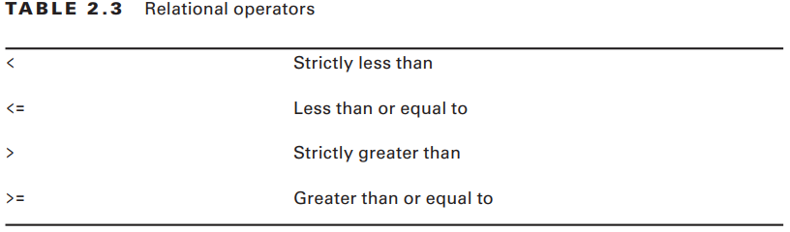
4-Using Additional Binary Operators
4-4) Relational Operators We now move on to relational operators, which compare two expressions and return a boolean value. The first four relational operators (see Table 2.3) are applied to numeric primitive data types only. If the two numeric operands are not of the same data type, the smaller one is promoted in the manner as previously discussed.

Slide 35
4-Using Additional Binary Operators
4-4) Relational Operators Let’s look at examples of these operators in action: int x = 10, y = 20, z = 10; System.out.println(x < y); // Outputs true System.out.println(x <= y); // Outputs true System.out.println(x >= z); // Outputs true System.out.println(x > z); // Outputs false Notice that the last example outputs false, because although x and z are the same value, x is not strictly greater than z. The fifth relational operator (Table 2.4) is applied to object references and classes or interfaces.

Slide 36
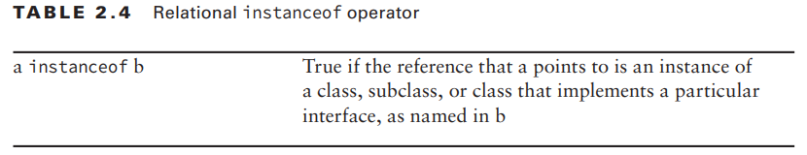
4-Using Additional Binary Operators
4-4) Relational Operators
The instanceof operator, while useful for determining whether an arbitrary object is a member of a particular class or interface, is out of scope for the OCA exam.

Slide 37
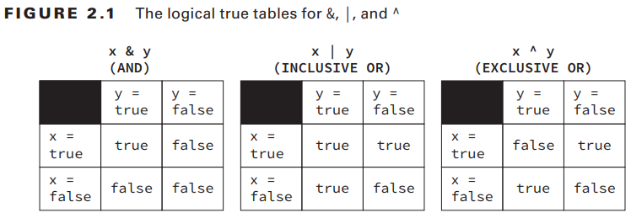
4-Using Additional Binary Operators
4-5) Logical Operators You should familiarize with the truth tables in Figure 2.1, where x and y are assumed to be boolean data types.

Slide 38
4-Using Additional Binary Operators
4-5) Logical Operators Here are some tips to help remember this table: ■ AND is only true if both operands are true. ■ Inclusive OR is only false if both operands are false. ■ Exclusive OR is only true if the operands are different. Finally, we present the conditional operators, && and ||, which are often referred to as short-circuit operators. The short-circuit operators are nearly identical to the logical operators, & and |, respectively, except that the right-hand side of the expression may never be evaluated if the final result can be determined by the left-hand side of the expression.

Slide 39
4-Using Additional Binary Operators
4-5) Logical Operators
For example, consider the following statement: boolean x = true || (y < 4);
Referring to the truth tables, the value x can only be false if both sides of the expression are false. Since we know the left-hand side is true, there’s no need to evaluate the right-hand side, since no value of y will ever make the value of x anything other than true. It may help you to illustrate this concept by executing the previous line of code for various values of y.

Slide 40
4-Using Additional Binary Operators
4-5) Logical Operators A more common example of where short-circuit operators are used is checking for null objects before performing an operation, such as this: if(x != null && x.getValue() < 5) { // Do something } In this example, if x was null, then the short-circuit prevents a NullPointerException from ever being thrown, since the evaluation of x.getValue() < 5 is never reached. Alternatively, if we used a logical &, then both sides would always be evaluated and when x was null this would throw an exception: if(x != null & x.getValue() < 5) { // Throws an exception if x is null // Do something }

Slide 41
4-Using Additional Binary Operators
4-5) Logical Operators Be wary of short-circuit behavior on the exam, as questions are known to alter a variable on the right-hand side of the expression that may never be reached. For example, what is the output of the following code? int x = 6; boolean y = (x >= 6) || (++x <= 7); System.out.println(x); Because x >= 6 is true, the increment operator on the right-hand side of the expression is never evaluated, so the output is 6.

Slide 42
4-Using Additional Binary Operators
4-6) Equality Operators
Determining equality in Java can be a nontrivial endeavor as there’s a semantic difference between “two objects are the same” and “two objects are equivalent.” It is further complicated by the fact that for numeric and boolean primitives, there is no such distinction.
Let’s start with the basics, the equals operator == and not equals operator !=. Like the relational operators, they compare two operands and return a boolean value about whether the expressions or values are equal, or not equal, respectively.

Slide 43
4-Using Additional Binary Operators
4-6) Equality Operators The equality operators are used in one of three scenarios: 1. Comparing two numeric primitive types. If the numeric values are of different data types, the values are automatically promoted as previously described. For example, 5 == 5.00 returns true since the left side is promoted to a double. 2. Comparing two boolean values. 3. Comparing two objects, including null and String values.

Slide 44
4-Using Additional Binary Operators
4-6) Equality Operators The comparisons for equality are limited to these three cases, so you cannot mix and match types. For example, each of the following would result in a compiler error: boolean x = true == 3; // DOES NOT COMPILE boolean y = false != "Giraffe"; // DOES NOT COMPILE boolean z = 3 == "Kangaroo"; // DOES NOT COMPILE

Slide 45
4-Using Additional Binary Operators
4-6) Equality Operators Pay close attention to the data types when you see an equality operator on the exam. The exam creators also have a habit of mixing assignment operators and equality operators, as in the following snippet: boolean y = false; boolean x = (y = true); System.out.println(x); // Outputs true

Slide 46
4-Using Additional Binary Operators
4-6) Equality Operators For object comparison, the equality operator is applied to the references to the objects, not the objects they point to. Two references are equal if and only if they point to the same object, or both point to null. Let’s take a look at some examples: File x = new File("myFile.txt"); File y = new File("myFile.txt"); File z = x; System.out.println(x == y); // Outputs false System.out.println(x == z); // Outputs true

Slide 47
5-Understanding Java Statements
We’ll be introducing you to various Java control ﬂow statements. Control ﬂow statements break up the ﬂow of execution by using decision making, looping, and branching, allowing the application to selectively execute particular segments of code.
These statements can be applied to single expressions as well as a block of Java code. As described in the previous chapter, a block of code in Java is a group of zero or more statements between balanced braces, ({}), and can be used anywhere a single statement is allowed.

Slide 48
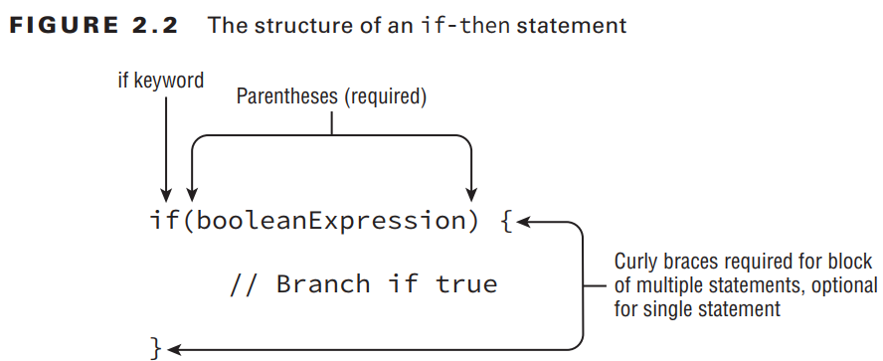
5-Understanding Java Statements
5-1) The if-then Statement
if(hourOfDay < 11) { System.out.println("Good Morning"); morningGreetingCount++; }

Slide 49
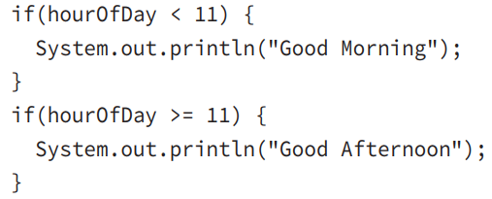
5-Understanding Java Statements
5-2) The if-then-else Statement Let’s expand our example a little. What if we want to display a different message if it is 11 a.m. or later? Could we do it using only the tools we have? Of course we can!

Slide 50
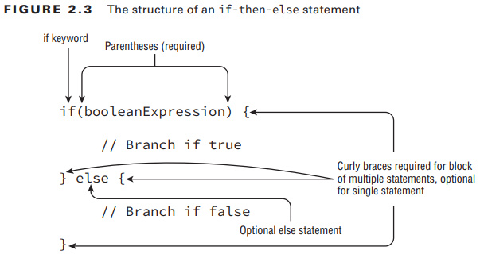
5-Understanding Java Statements
5-2) The if-then-else Statement

Slide 51
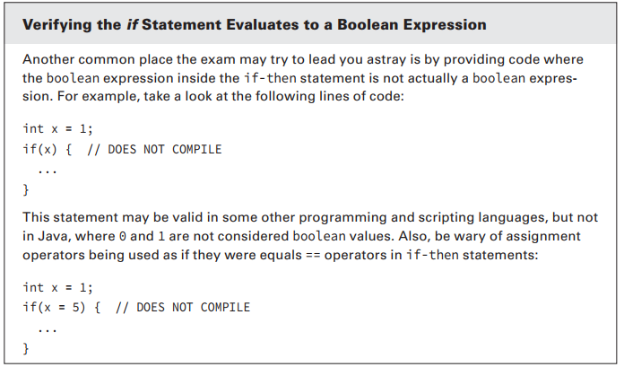
5-Understanding Java Statements
5-2) The if-then-else Statement

Slide 52
5-Understanding Java Statements
5-3) Ternary Operator
Now that we have discussed if-then-else statements, we can brieﬂy return to our discussion of operators and present the final operator that you need to learn for the exam. The conditional operator, ? :, otherwise known as the ternary operator, is the only operator that takes three operands and is of the form: booleanExpression ? expression1 : expression2

Slide 53
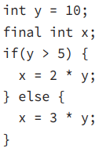

5-Understanding Java Statements
5-3) Ternary Operator
For example, the following two snippets of code are equivalent:
Note that it is often helpful for readability to add parentheses around the expressions in ternary operations, although it is certainly not required.

Slide 54
5-Understanding Java Statements
5-3) Ternary Operator
There is no requirement that second and third expressions in ternary operations have the same data types, although it may come into play when combined with the assignment operator. Compare the following two statements: System.out.println((y > 5) ? 21 : "Zebra"); int animal = (y < 91) ? 9 : "Horse"; // DOES NOT COMPILE

Slide 55
5-Understanding Java Statements
5-4) The switch Statement
Supported Data Types As shown in Figure 2.4, a switch statement has a target variable that is not evaluated until runtime. Prior to Java 5.0, this variable could only be int values or those values that could be promoted to int, specifically byte, short, char, or int. When enum was added in Java 5.0, support was added to switch statements to support enum values. In Java 7, switch statements were further updated to allow matching on String values. Finally, the switch statement also supports any of the primitive numeric wrapper classes, such as Byte, Short, Character, or Integer.

Slide 56
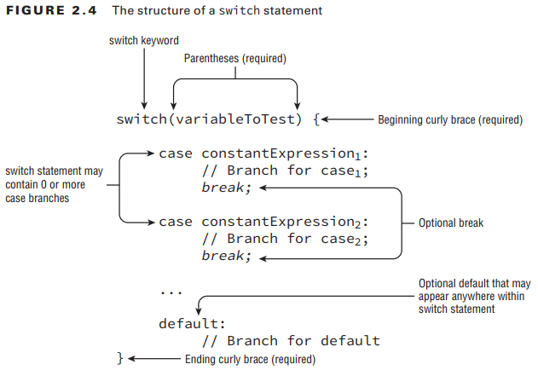
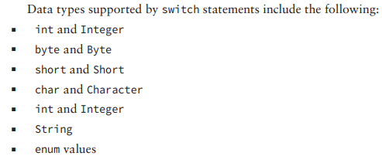
5-Understanding Java Statements
5-4) The switch Statement
For the exam, we recommend you memorize this list. Note that boolean and long, and their associated wrapper classes, are not supported by switch statements.

Slide 57
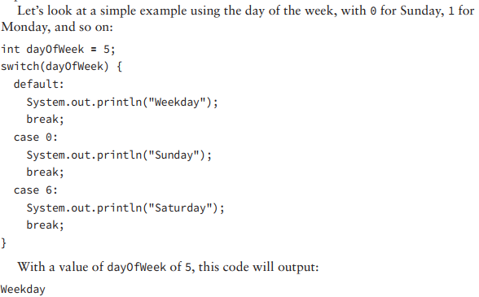
5-Understanding Java Statements
5-4) The switch Statement
There is no requirement that
the case or default statements
be in a particular order

Slide 58
5-Understanding Java Statements
The order of the case and default statements is now important since placing the default statement at the end of the switch statement would cause only one word to be output. What if the value of dayOfWeek was 6 in this example? Would the default block still be executed? The output of this example with dayOfWeek set to 6 would be: Saturday
Finally, if the value of dayOfWeek was 0, all three statements would be output: Sunday Weekday Saturday
5-4) The switch Statement
Consider the following variation: int dayOfWeek = 5; switch(dayOfWeek) { case 0: System.out.println("Sunday"); default: System.out.println("Weekday"); case 6: System.out.println("Saturday"); break; }

Slide 59
5-Understanding Java Statements
5-4) The switch Statement
We conclude our discussion on switch statements by acknowledging that the data type for case statements must all match the data type of the switch variable. As already discussed, the case statement value must also be a literal, enum constant, or final constant variable.
Given the following switch statement, notice which case statements will
compile and which will not:

Slide 60
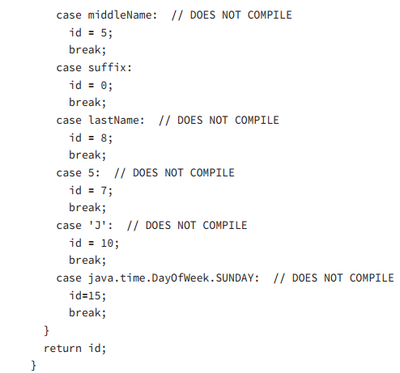
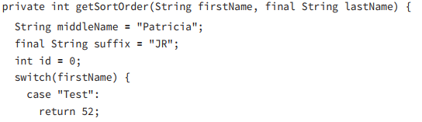
5-Understanding Java Statements
5-4) The switch Statement

Slide 61
5-Understanding Java Statements
5-4) The switch Statement
The first case statement compiles without issue using a String literal and is a good example of how a return statement, like a break statement, can be used to exit the switch statement early. The second case statement does not compile because middleName is not a final variable, despite having a known value at this particular line of execution. The third case statement compiles without issue because suffix is a final constant variable. In the fourth case statement, despite lastName being final, it is not constant as it is passed to the function; therefore, this line does not compile as well. Finally, the last three case statements don’t compile because none of them have a matching type of String; the last one is an enum value.

Slide 62
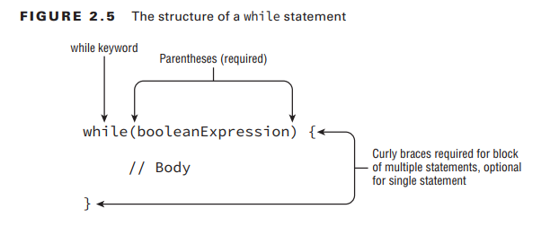
5-Understanding Java Statements
5-5) The while Statement

Slide 63
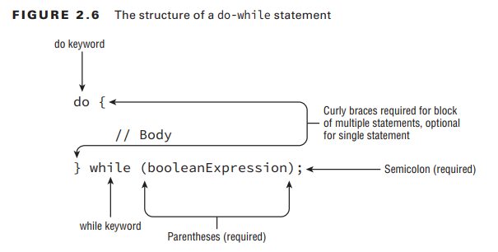
5-Understanding Java Statements
5-6) The do-while Statement
int x = 0; do { x++; } while(false); System.out.println(x); // Outputs 1

Slide 64
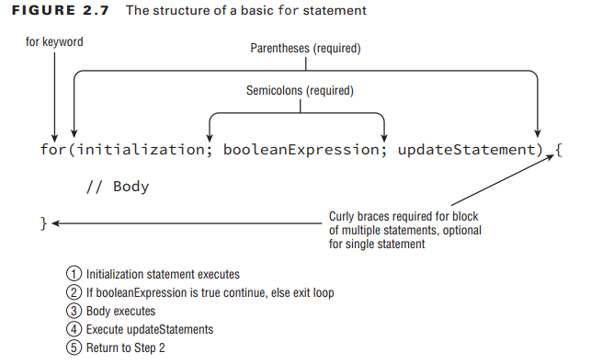
5-Understanding Java Statements
5-7) The for Statement
Creating an Infinite Loop for( ; ; ) { System.out.println("Hello World"); }
2. Adding Multiple Terms to the for Statement int x = 0; for(long y = 0, z = 4; x < 5 && y < 10; x++, y++) { System.out.print(y + " "); } System.out.print(x);

Slide 65
5-Understanding Java Statements
5-7) The for Statement
3. Redeclaring a Variable in the Initialization Block int x = 0; for(long y = 0, x = 4; x < 5 && y < 10; x++, y++) { // DOES NOT COMPILE System.out.print(x + " "); } We can fix this loop by changing the declaration of x and y as follows: int x = 0; long y = 10; for(y = 0, x = 4; x < 5 && y < 10; x++, y++) { System.out.print(x + " "); }

Slide 66
5-Understanding Java Statements
5-7) The for Statement The variables in the initialization block must all be of the same type. 5. Using Loop Variables Outside the Loop for(long y = 0, x = 4; x < 5 && y < 10; x++, y++) { System.out.print(y + " "); } System.out.print(x); // DOES NOT COMPILE
4. Using Incompatible Data Types in the Initialization Block for(long y = 0, int x = 4; x < 5 && y<10; x++, y++) { // DOES NOT COMPILE System.out.print(x + " "); }

Slide 67
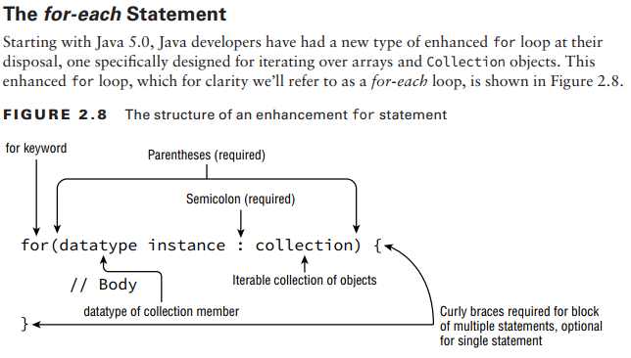
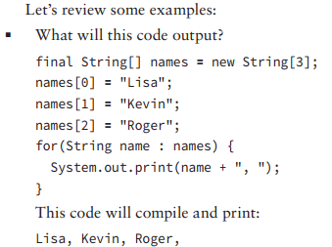
5-Understanding Java Statements
5-7-2) The for-each Statement

Slide 68
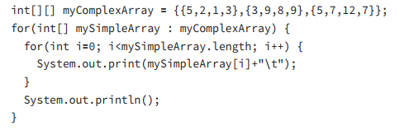
6-Understanding Advanced Flow Control
6-1) Nested Loops

Slide 69
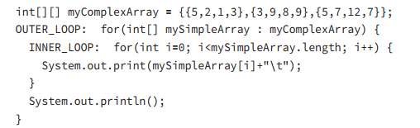
6-Understanding Advanced Flow Control
6-2) Adding Optional Labels

Slide 70
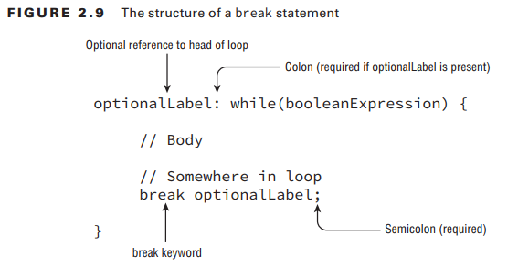
6-Understanding Advanced Flow Control
6-3) The break Statement

Slide 71
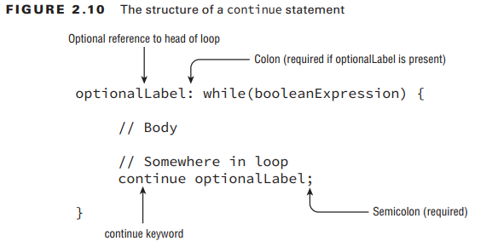
6-Understanding Advanced Flow Control
6-4) The continue Statement

